Slide 1

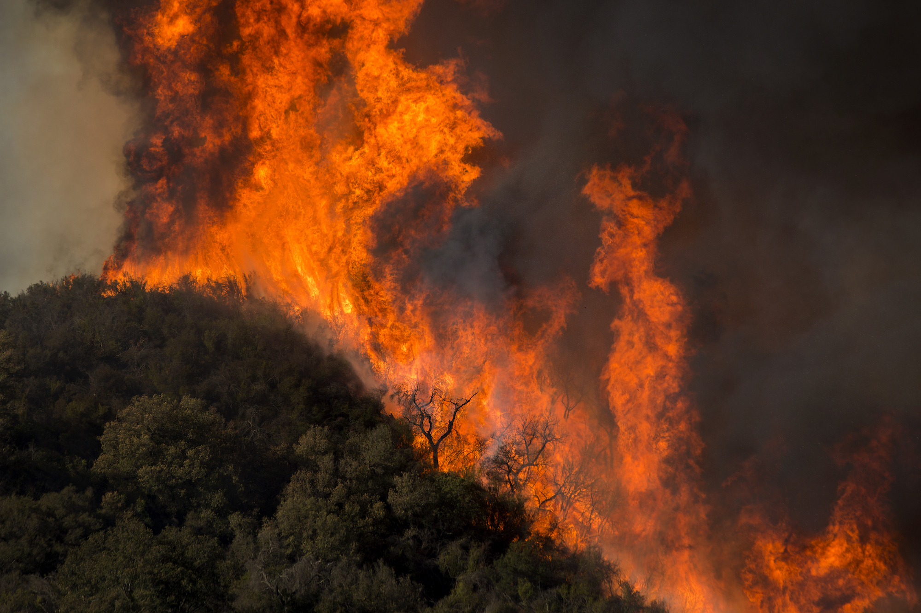

Wildfire Land Degradation in Brazil
BY TEAM INSPECT
Notes:
Welcome everyone, we are team Inspect, let’s jump into our presentation for this case study.

Slide 2
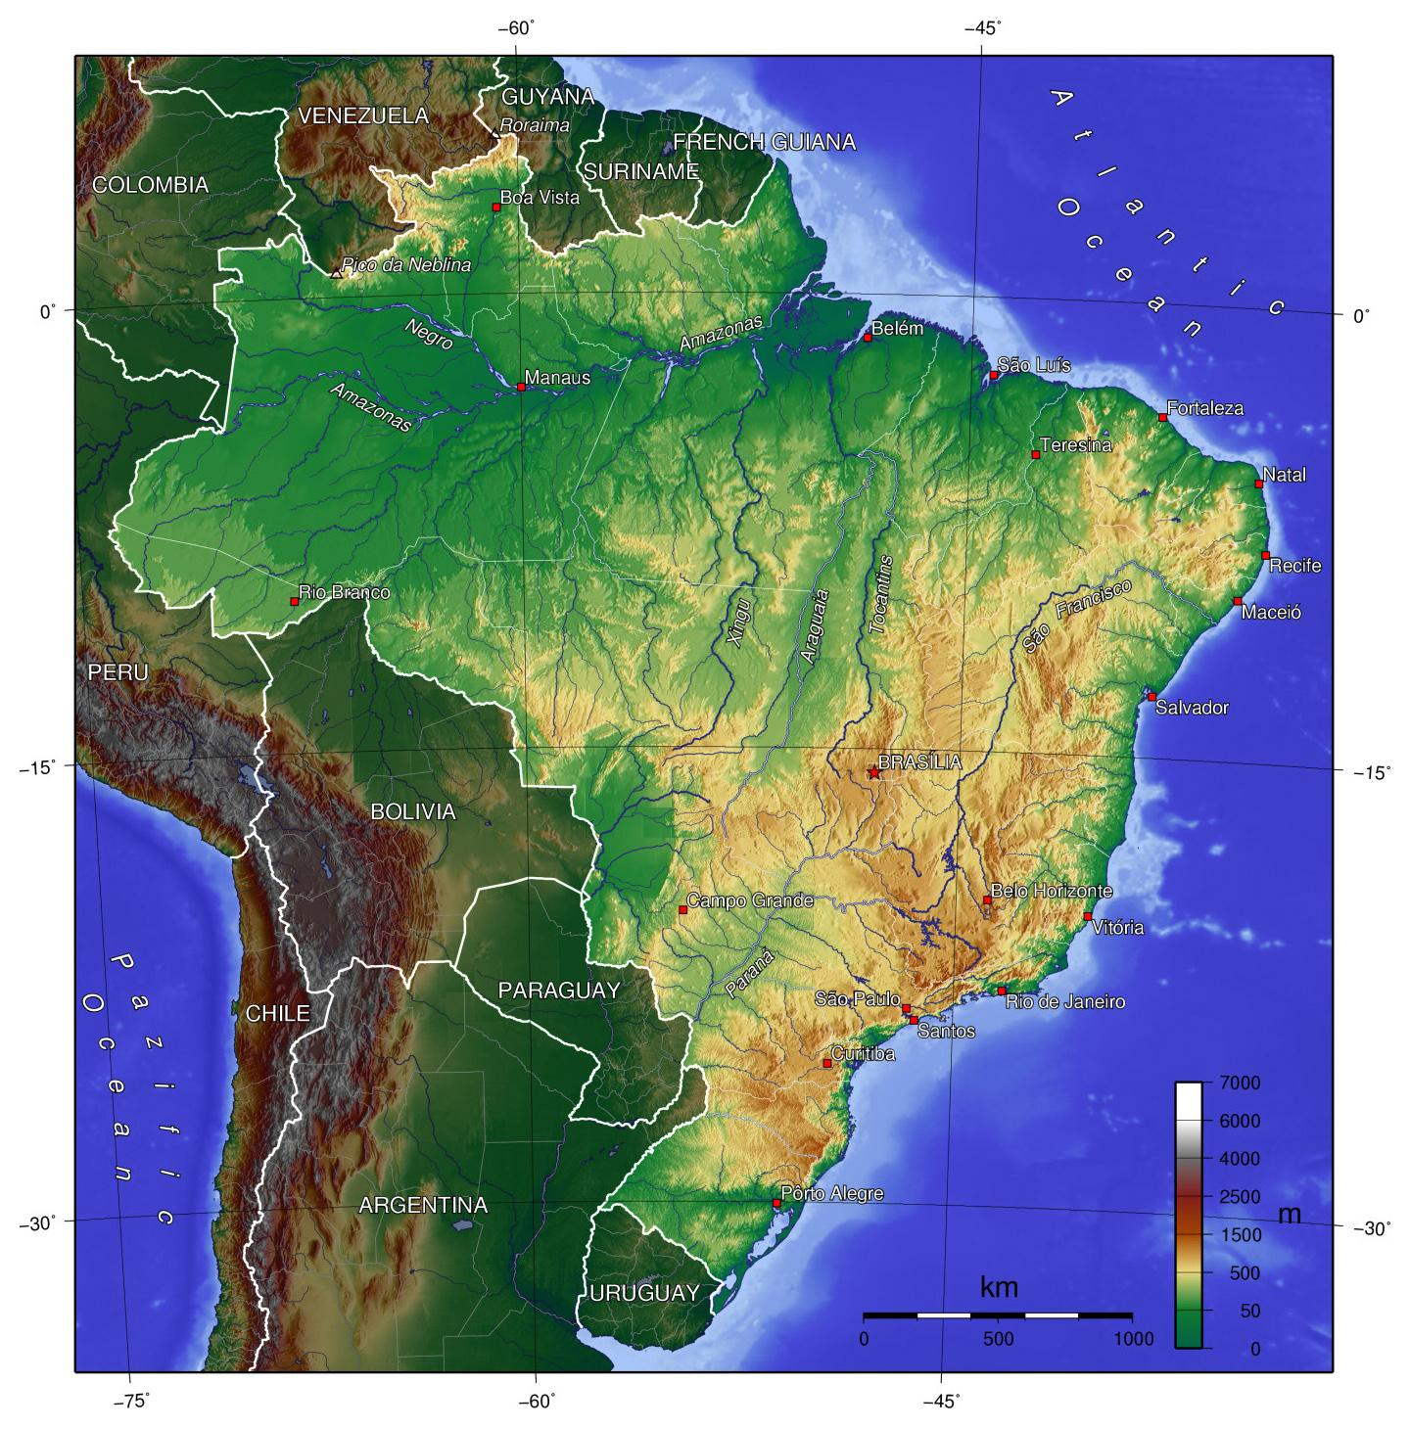
Issue
Wildfires are causing widespread land degradation in Brazil
Large scale damage on ecosystems, populations
More than 70% are caused by humans¹
1. Gollnow, F., Cammelli, F., Carlson, K. M., & Garrett, R. D. (2022, October 28). Gaps in adoption and implementation limit the current and potential effectiveness of zero-deforestation supply chain policies for soy. Environmental Research Letters. doi: 10.1088/1748-9326/ac97f6
Notes:
Wildfires are causing the land degradation, damagine ecosystems and populations. More than 70% of them are caused by humans.

Slide 3
Origin of the issue
UNRELATED HUMAN ACTIVITY
⬆️ CO2
⬆️ TEMPERATURE
HIGHER GDP
HIGHER BEEF
DEMAND
HIGHER SOYA
DEMAND
DEFORESTATION
FIRE

Slide 4
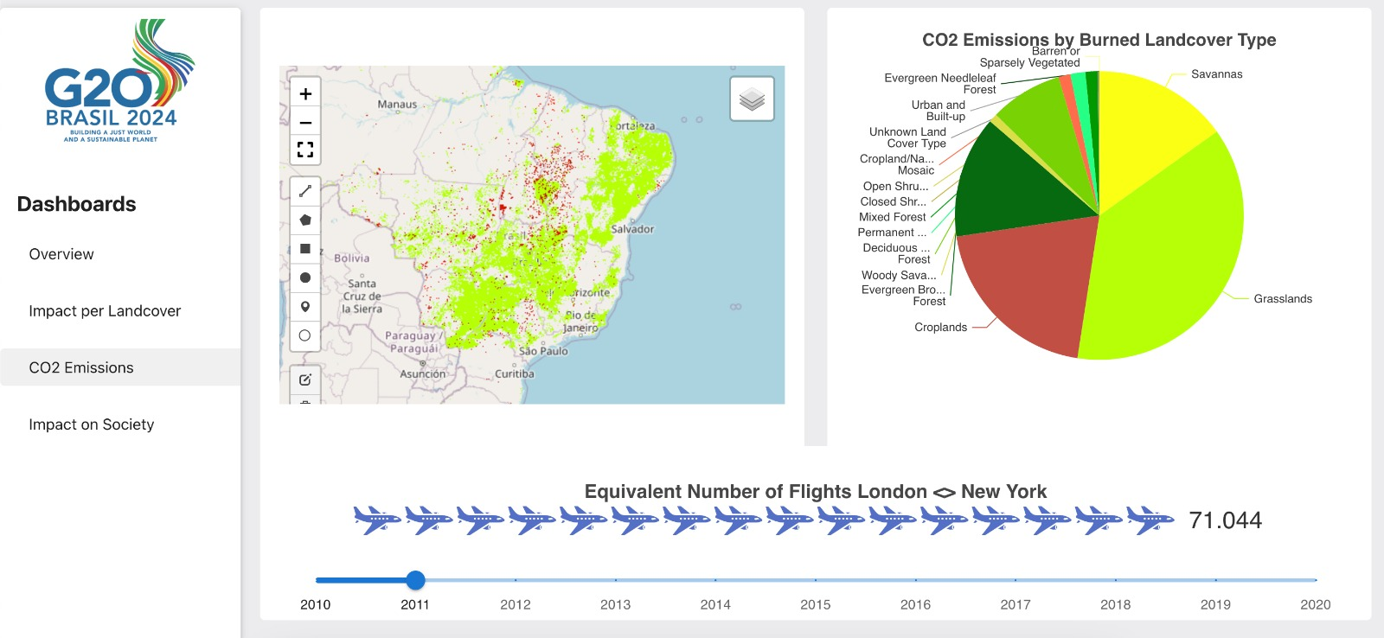
Web app for understanding data
Notes:
We need to quantify the problems, and visualize the data in a comprehensive fashion, to understand the reality of the current situation. There is a need for a tool to simplify the complex data, here comes to help our tool

Slide 5

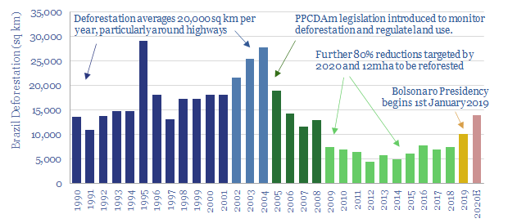
Trend of the last 30 years
Notes:
We need to quantify the problems, and visualize the data in a comprehensive fashion, to understand the reality of the current situation. There is a need for a tool to simplify the complex data, here comes to help our tool

Slide 6
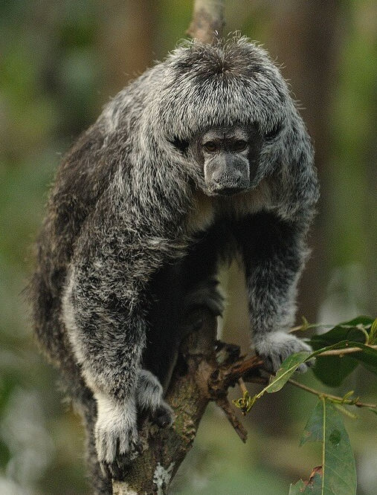
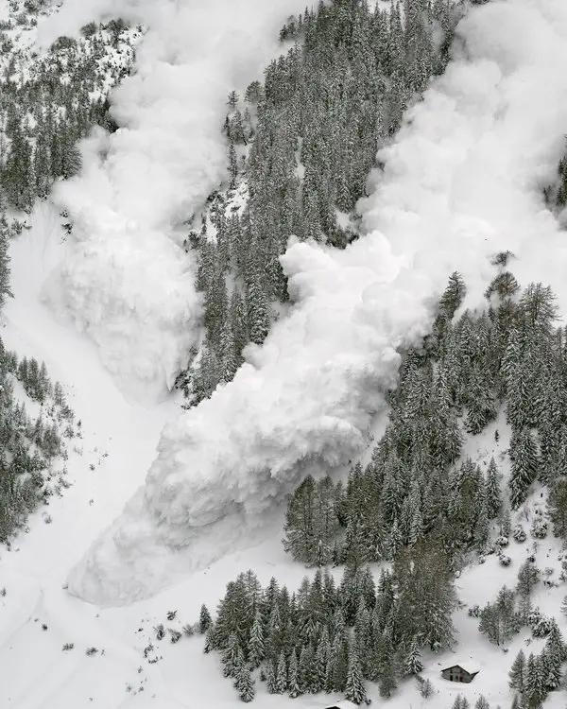
General risks
CO2 Emissions & Ambiental risks
Biodiversity
Notes:
Risks are generalized for all the world population. We know that the atmosphere phenomena are chaotic, and small changes somewhere can have great impact somewhere else.

Slide 7
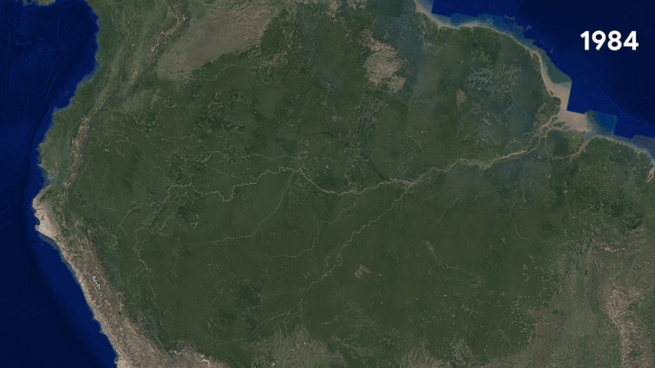
Risks for Brazil: Land degradation and Agriculture
Notes:
We need to quantify the problems, and visualize the data in a comprehensive fashion, to understand the reality of the current situation. There is a need for a tool to simplify the complex data, here comes to help our tool

Slide 8
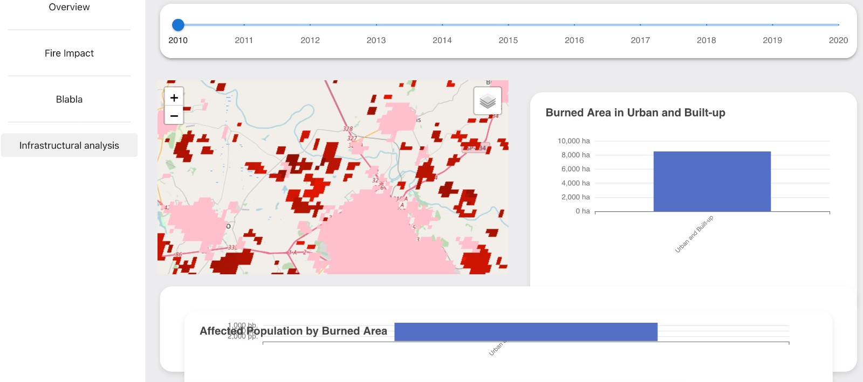
Risks for Brazil: Population and Infrastructures
Notes:
We need to quantify the problems, and visualize the data in a comprehensive fashion, to understand the reality of the current situation. There is a need for a tool to simplify the complex data, here comes to help our tool

Slide 9
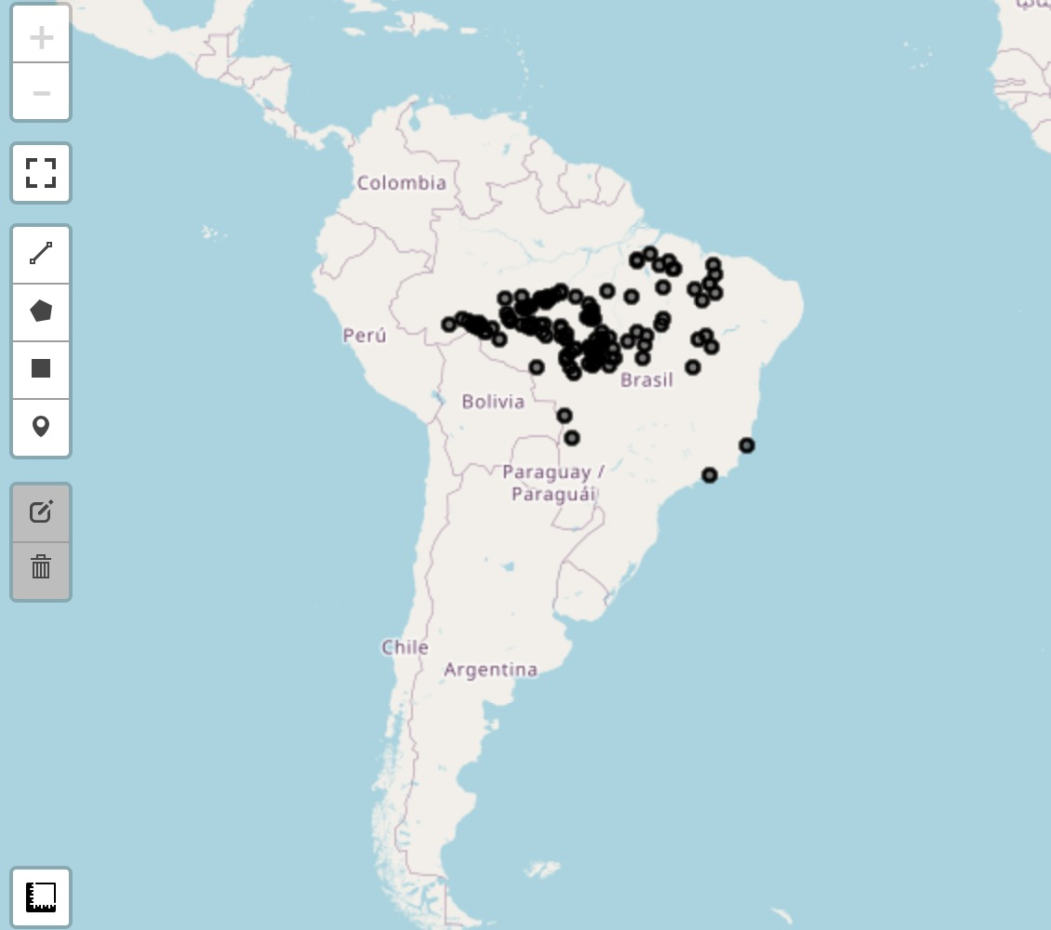



Assisted Wild-Fire Management
AI Driven determination of potential location of future wild-fires
Identify risks for the population early enough. The countries should cooperate to finance in research to enhance current state of the are.
More efficient intervention.
Only act with preventive measures if they are probably useful.

Slide 10







Any questions?
Johannes Getznir
Machine Learning Engineer
Elinic AG
Maritz Awad
Computer Science Student
TUM Münich
Mauro Leidi
Research Engineer
The Sense Research Center
Gioele Monopoli
Founder
Medica AI

